Slide 1
Quick Sort

Slide 2
Quick Sort
Quick sort is a divide-and-conquer sorting algorithm.
Partitioning is static in the case of Merge Sort algorithm. The list is divided into two near halves.
In Quick sort, partitioning is dynamic and the sizes of the two lists are not be the same. It depends on the elements present in the list.

Slide 3
Algorithm Partition( a, low, high) { v = a[low]; i = low+1; j = high; while ( i < = j ) do { while( a[i] <= v && i <= high) do i = i+1; while( a[j] > v && j > low) do j=j-1; if (i < j) then swap( a[i], a[j]); } swap( v, a[j]); return j; }
Algorithm QuickSort (a, low, high)
{
if ( low < high)
{
k=partition( a, low, high);
QuickSort( a, low, k-1);
QuickSort ( a, k+1, high);
}
}

Slide 4

Algorithm Partition( a, low, high) { v = a[low]; i = low+1; j = high; while ( i < = j ) do { while( a[i] <= v && i <= high) do i = i+1; while( a[j] > v && j > low) do j=j-1; if (i < j) then swap( a[i], a[j]); } swap( v, a[j]); return j; }
Algorithm QuickSort (a, low, high)
{
if ( low < high)
{
k=partition( a, low, high);
QuickSort( a, low, k-1);
QuickSort ( a, k+1, high);
}
}

Slide 5

Algorithm Partition( a, low, high) { v = a[low]; i = low+1; j = high; while ( i < = j ) do { while( a[i] <= v && i <= high) do i = i+1; while( a[j] > v && j > low) do j=j-1; if (i < j) then swap( a[i], a[j]); } swap( v, a[j]); return j; }
Algorithm QuickSort (a, low, high)
{
if ( low < high)
{
k=partition( a, low, high);
QuickSort( a, low, k-1);
QuickSort ( a, k+1, high);
}
}

Slide 6
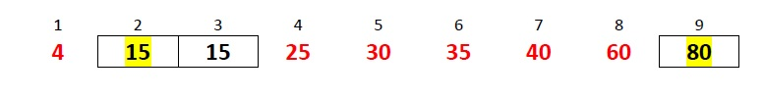
Algorithm Partition( a, low, high) { v = a[low]; i = low+1; j = high; while ( i < = j ) do { while( a[i] <= v && i <= high) do i = i+1; while( a[j] > v && j > low) do j=j-1; if (i < j) then swap( a[i], a[j]); } swap( v, a[j]); return j; }
Algorithm QuickSort (a, low, high)
{
if ( low < high)
{
k=partition( a, low, high);
QuickSort( a, low, k-1);
QuickSort ( a, k+1, high);
}
}

Slide 7

Algorithm Partition( a, low, high) { v = a[low]; i = low+1; j = high; while ( i < = j ) do { while( a[i] <= v && i <= high) do i = i+1; while( a[j] > v && j > low) do j=j-1; if (i < j) then swap( a[i], a[j]); } swap( v, a[j]); return j; }
Algorithm QuickSort (a, low, high)
{
if ( low < high)
{
k=partition( a, low, high);
QuickSort( a, low, k-1);
QuickSort ( a, k+1, high);
}
}

Slide 8

Algorithm Partition( a, low, high) { v = a[low]; i = low+1; j = high; while ( i < = j ) do { while( a[i] <= v && i <= high) do i = i+1; while( a[j] > v && j > low) do j=j-1; if (i < j) then swap( a[i], a[j]); } swap( v, a[j]); return j; }
Algorithm QuickSort (a, low, high)
{
if ( low < high)
{
k=partition( a, low, high);
QuickSort( a, low, k-1);
QuickSort ( a, k+1, high);
}
}

Slide 9
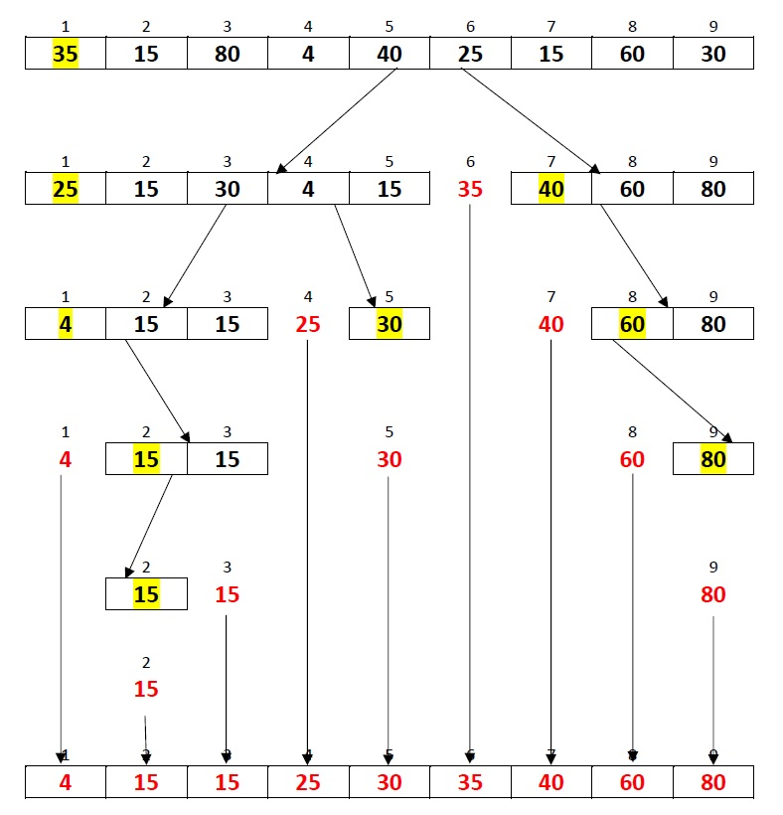
Quick Sort Average Case Example

Slide 10
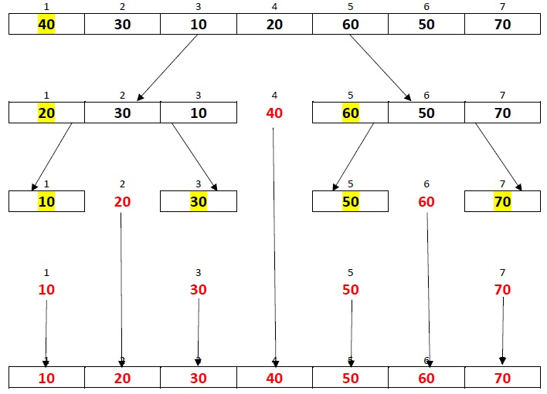
Quick Sort Best Case Example

Slide 11
Quick Sort Best Case Time Complexity
Lets T(n) be the time complexity for best cases & n = total number of elements then
T(n) = 2*T(n/2) + constant*n
2*T(n/2) is because we are dividing array into two array of equal size
constant*n is because we will be traversing elements of array in each level of tree
∴ , T(n) = 2*T(n/2) + constant*n
further we will divide array in to array of equal size so
T(n) = 2*(2*T(n/4) + constant*n/2) + constant*n == 4*T(n/4) + 2*constant*n
for this we can say that
T(n) = 2^k * T(n/(2^k)) + k*constant*n
then n = 2^k and k = log2(n)
∴, T(n) = n * T(1) + n*logn = O(n*log2(n))

Slide 12
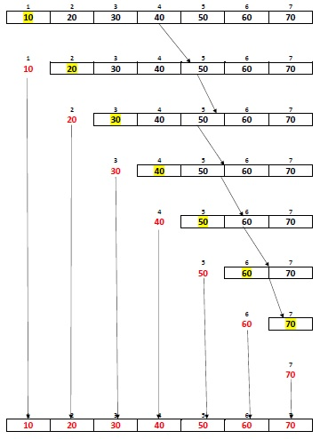
Quick Sort Worst Case Example

Slide 13
Quick Sort Worst Case Time Complexity
lets T(n) ne total time complexity for worst case and n = total number of elements
T(n) = T(n-1) + constant*n
as we are dividing array into two parts one consist of single element and other of n-1
and we will traverse individual array
T(n) = T(n-2) + constant*(n-1) + constant*n = T(n-2) + 2*constant*n - constant
T(n) = T(n-3) + 3*constant*n - 2*constant - constant
T(n) = T(n-k) + k*constant*n - (k-1)*constant ..... - 2*constant - constant
T(n) = T(n-k) + k*constant*n - constant*[(k-1) .... + 3 + 2 + 1]
T(n) = T(n-k) + k*n*constant - constant*[k*(k-1)/2]
put n=k
T(n) = T(0) + constant*n*n - constant*[n*(n-1)/2]
removing constant terms
T(n) = n*n - n*(n-1)/2
T(n) = O(n^2)

Slide 14
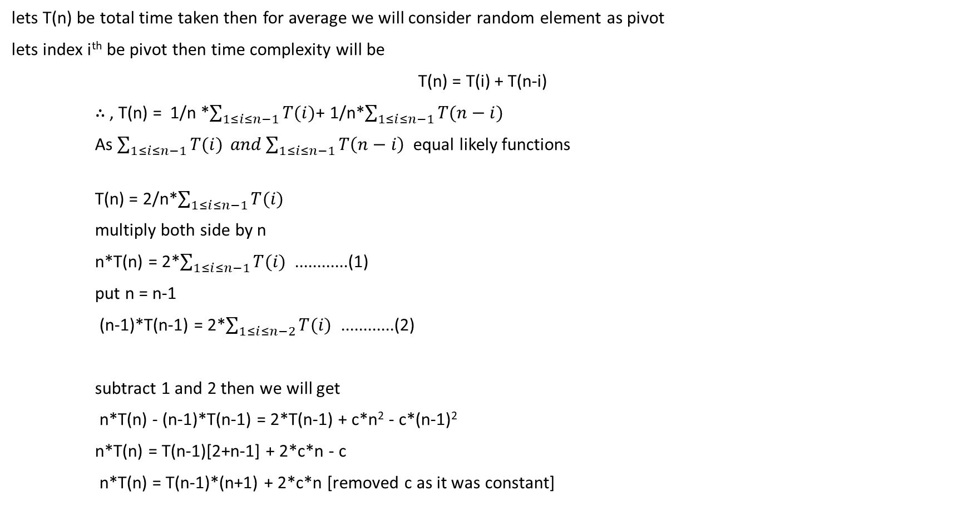
Quick Sort Average Case Time Complexity
lets T(n) be total time taken then for average we will consider random element as pivot
lets index i^{th} be pivot then time complexity will be
T(n) = T(i) + T(n-i)
∴ , T(n) = 1/n *$\sum_{1≤i≤n−1}{T(i)}$+ 1/n*$\sum_{1≤i≤n−1}{T(n−i)}$
As $\sum_{1≤i≤n−1}{T(i)} and\sum_{1≤i≤n−1}{T\left(n−i\right) }$ equal likely functions
T(n) = 2/n*$\sum_{1≤i≤n−1}{T(i)}$
multiply both side by n
n*T(n) = 2*$\sum_{1≤i≤n−1}{T(i)}$ ............(1)
put n = n-1
(n-1)*T(n-1) = 2*$\sum_{1≤i≤n−2}{T(i)}$ ............(2)
subtract 1 and 2 then we will get
n*T(n) - (n-1)*T(n-1) = 2*T(n-1) + c*n² - c*(n-1)²
n*T(n) = T(n-1)[2+n-1] + 2*c*n - c
n*T(n) = T(n-1)*(n+1) + 2*c*n [removed c as it was constant]
i | T(i) | T(n-i)
1 | T(1) | T(n-1)
2 | T(2) | T(n-2)
3 | T(3) | T(n-3)
. | . | .
. | . | .
n-3 | T(n-3) | T(3)
n-2 | T(n-2) | T(2)
n-1 | T(n-1) | T(1)

Slide 15
Quick Sort Average Case Time Complexity
divide both side by n*(n+1),
T(n)/(n+1) = T(n-1)/n + 2*c/(n+1) .............(3)
put n = n-1,
T(n-1)/n = T(n-2)/(n-1) + 2*c/n ............(4)
put n = n-2,
T(n-2)/(n-1) = T(n-3)/(n-2) + 2*c/(n-1) ............(5)
by putting 4 in 3 and then 3 in 2 we will get
T(n)/(n+1) = T(n-2)/(n-1) + 2*c/(n-1) + 2*c/n + 2*c/(n+1)
also we can find equation for T(n-2) by putting n = n-2 in (3)
at last we will get
T(n)/(n+1) = T(1)/2 + 2*c * [1/(n-1) + 1/n + 1/(n+1) + .....]
T(n)/(n+1) = T(1)/2 + 2*c*log(n) + C
T(n) = 2*c*log(n) * (n+1)
now by removing constants,
T(n) = log(n)*(n+1)
∴, T(n) = O(n*log(n))

